Slide 1
Solving Dysgraphia
Abdulrahman Alsalem, Amine Ben Jemia, Marcus Frinton, Yashoheet Sethi

Slide 2
What is Dysgraphia?
Dysgraphia is a learning disability that affects handwriting skills. It is characterized by difficulties in spelling, poor handwriting, and trouble with the thought processes needed to form sentences.

Slide 3
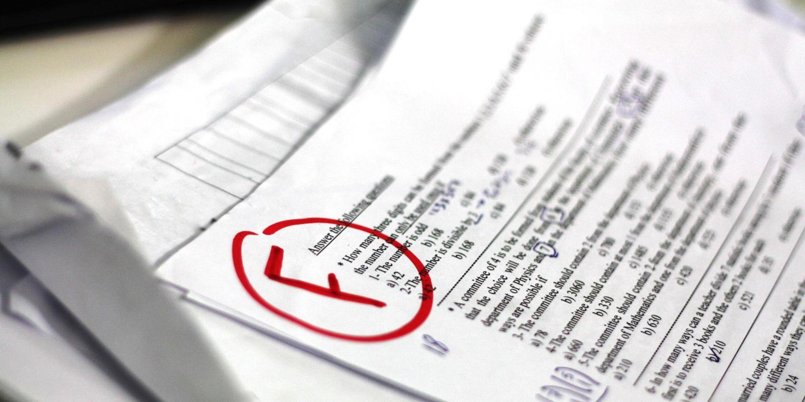
Need For Solution
Children with dysgraphia face significant educational hurdles compared to an average student. This is because when the act of developing ideas through writing is needed, they cant put these thoughts down onto paper without difficulty. This fosters academic discouragement within students. Thus, we need to come up with a solution that enables them to overcome these hardships.

Slide 4
Problem Statement
The clients, consumers with dysgraphia, require a device that helps them to improve their writing ability, as writing is very important aspect of one’s life. Clients who go on without solving this issue face psychological and compositional hardships.

Slide 5
Stakeholders
The stakeholders are:
the designers of the solution
the children afflicted with dysgraphia
the family members of the children
educators of the children
the education business as a whole
the healthcare industry.

Slide 6
Criteria & Constraints of Solutions
Criteria:
1-Storable
2- Aesthetically Pleasing
3- Low Production Cost
Constraints:
1-Simple, Easy to Use design
2-Low Cost to Consumers
3- High Safety Ratings

Slide 7
Our Solution

Slide 8
Train of Thought in Solution
After researching the symptoms of dysgraphia, we found key symptoms to solve:
Their cramped grip
Frequent erasing
Inconsistency in letter and word spacing
Poor spelling
We set out to find a solution with those symptoms in mind. We wanted a solution that doesn't need to be erased, does not include a grip , consistent and clear in displaying the spacing between letters, and helps the consumers to develop a strong foundation of muscle memory.

Slide 9
Projector Sandbox
The product consists of :
The top unit that contains the projector and its sensors
The kinetic sand
The container (the box)
How does it work? The sensors and projectors project text onto the sand. The user traces the projected text, as the successfully traced path darkens out, leaving the untraced path still illuminated. Once finished, the projector will display the letter again in green while indicating the missed parts in red.

Slide 10
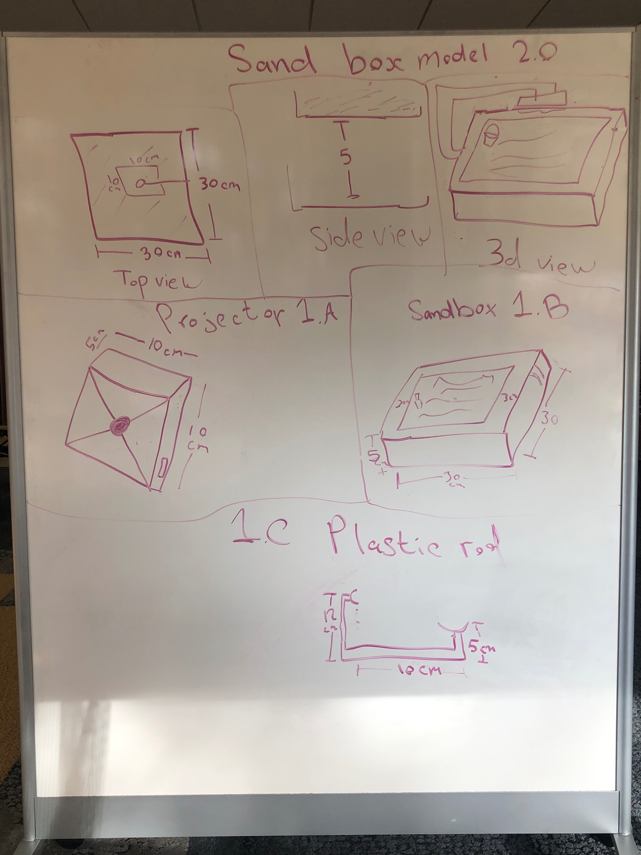
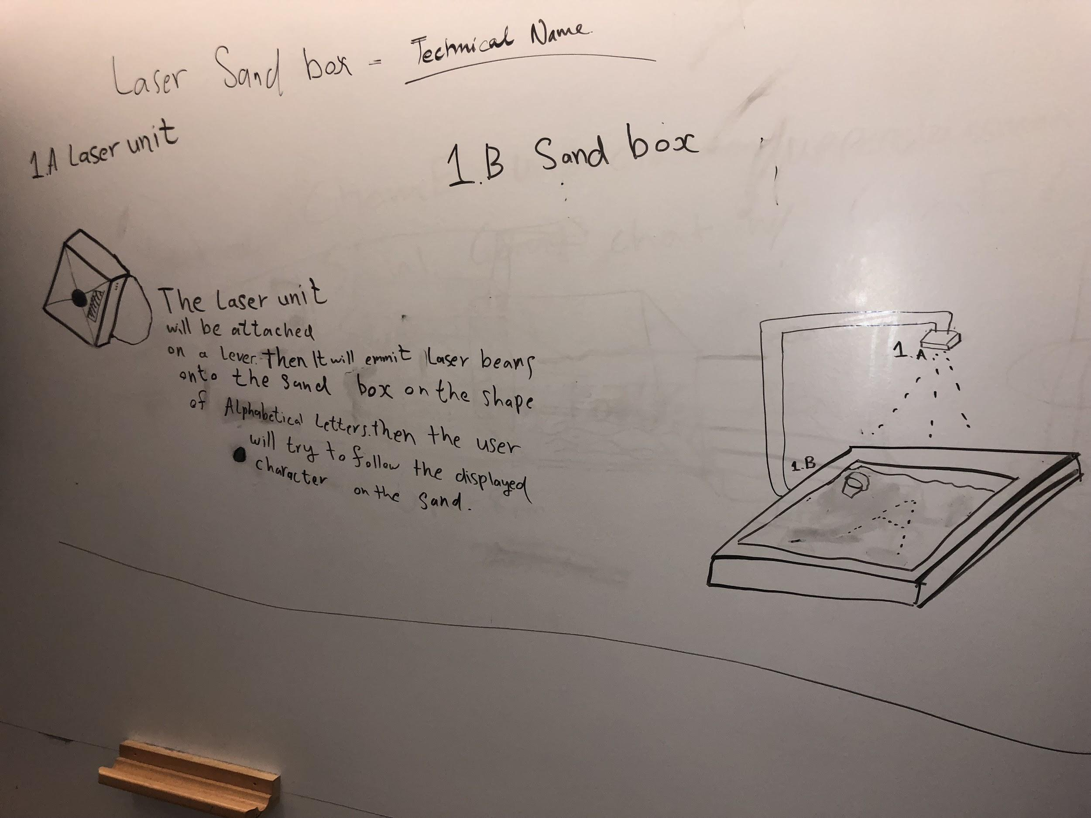
Projector Sandbox Sketches
Notes:
gnremy,kutku.

Slide 11
Why the Sandbox ?
Achieved Highest Score in the Weighted Decision Matrix.
Small, storable, and aesthetically pleasing design
Volume and shape after assembly
Volume and Shape before assembly
Simple Design
Time to assemble
Suitable Production and Retail value for everyone
Monetary Cost
Safe Product
Safety Rating

Slide 12
Weaknesses of the Product
There is a finite amount of Kinetic Sand
The core of the product is concentrated in the Upper unit.
While assembling and disassembling the product parts could be lost (e.g. screws).
Assumptions about the Product
1. The material protecting the Upper Unit is strong.
2. The cost of the Upper Unit components align in keeping our products inexpensive.

Slide 13
Research Data
We conducted experiments and collected data and decided to use kinetic sand due to the following reasons.
It is non toxic and doesn’t stick to one’s hand.
Its polymer coating helps make more legible characters. This is very important as the more clarity in the characters, the more clearly the concepts can be grasped.
90–98% of children with developmental and learning disabilities have problems in getting to an average level of handwriting proficiency for their age.
Repetitive writing practices helps develop motor skills and instills muscle memory which aids them in becoming better writers and hence improving their academic performance.

Slide 14
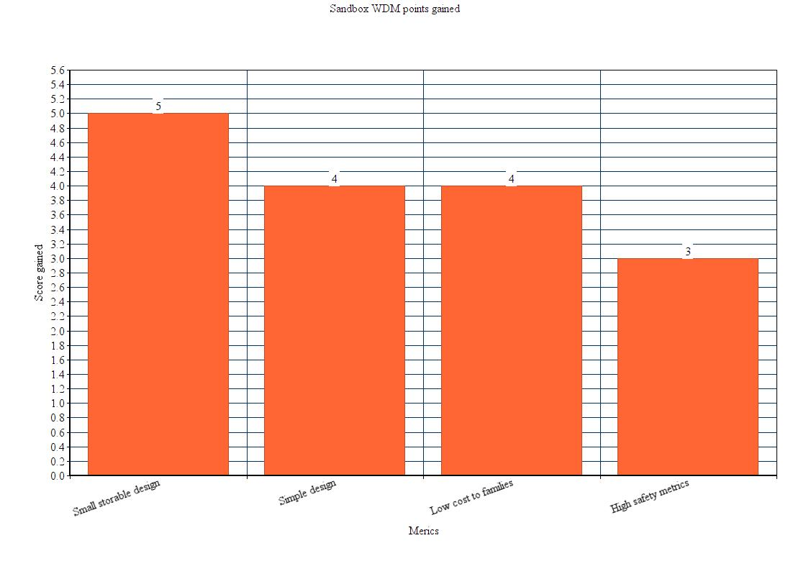
Research Data
Meets the defined need of helping the consumers get over the educational hurdle, by improving their muscle memory and spatial awareness when writing.
Uses textile feedback from the sand while also building character knowledge, which helps maximize the benefit of the product.

Slide 15
Final Remarks
Our group concluded with respect to our solution:
Dysgraphia is a rather unknown condition that has drastic effects on its victims.
We wanted to help shed light on dysgraphia by promoting a solution that could be utilized for a low price point.
We designed the solution with children in mind as they have untapped potential that is hindered by not treating dysgraphia.

Slide 16
References
Frye, Devon. “What Is Dysgraphia?” ADDitude, ADDitude, 25 Sept. 2018, www.additudemag.com/what-is-dysgraphia-understanding-common-symptoms/
Dysgraphia Information Page, National Institute of Neurological Disorders and Stroke (NINDS). (n.d.). Retrieved from https://www.ninds.nih.gov/Disorders/All-Disorders/Dysgraphia-Information-Page
Brendan Weekes (1996) Surface Dyslexia and Surface Dysgraphia: Treatment Studies and Their Theoretical Implications, Cognitive Neuropsychology, 13:2, 277-315, DOI: 10.1080/026432996382033

Slide 17
Thank you for listening.
Questions?

